Slide 1
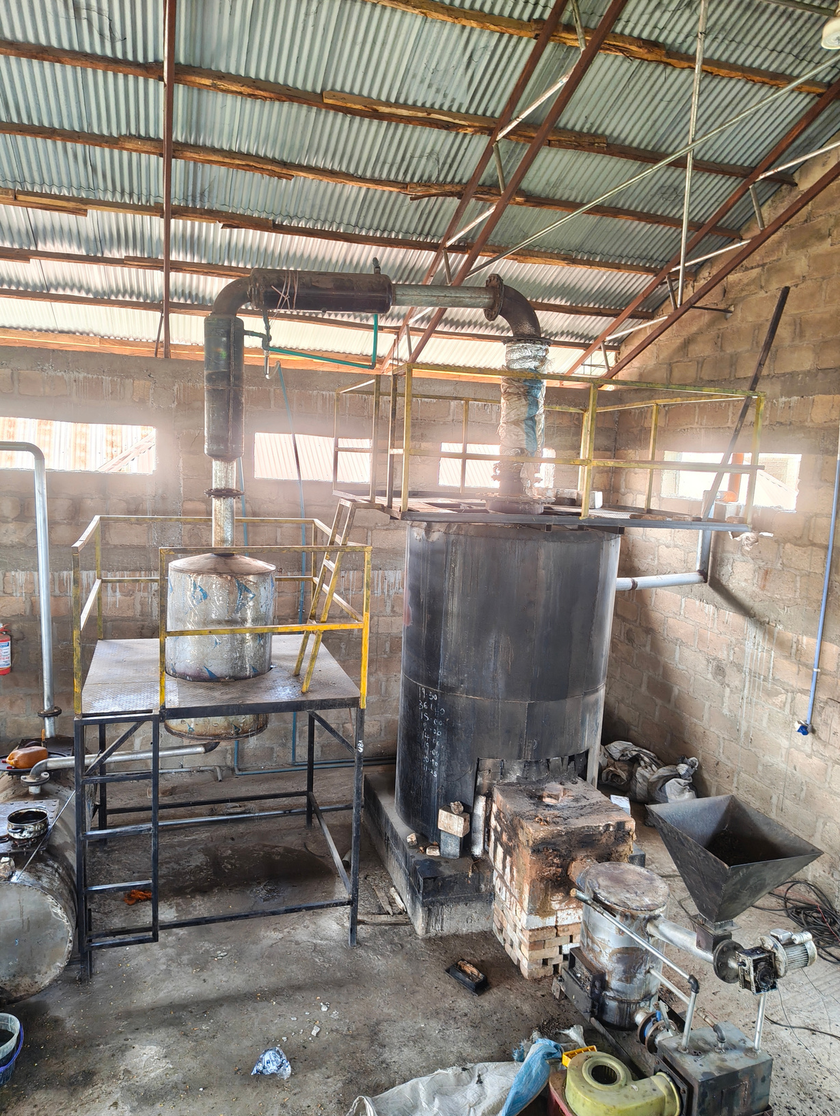
Techno-Economic Analysis of Conversion of Plastic Waste into Diesel Fuel in Nigeria
A Case Study of Premium Blue Economy Innovations Ltd.
By: Oreoluwa, Precious Ayomide
Matric No: 253054
Notes:
1

Slide 2
Presentation Outline
01
Introduction
05
Literature Review
02
Problem
06
Methodology
03
Aim & Objective
07
Conclusion
04
Significance
08
Reference

Slide 3
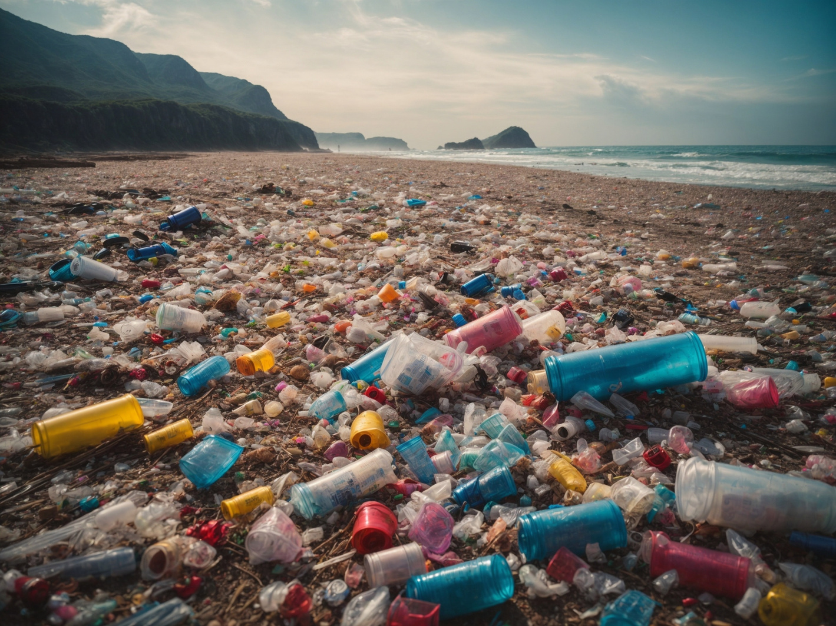
Introduction
  Global plastic production reached approx. 450 Mt annually by 2025
  Plastic pollution entering the environment totals 130 Mt/year
  Nigeria generates approx. 2.5 million tonnes of plastic waste annually
  Nigeria ranks 89.09% on the Mismanaged Waste Index, that is, nearly nine-tenths ends up in the environment
  Thermal pyrolysis can convert selected waste plastics into condensable liquid products, non-condensable gas and solid residues.

Slide 4
Problem Statement
Waste Crisis
Energy Deficit
Research Gap
60 million sachets discarded daily, blocking drainage and causing urban flooding. Recycling rates remain below 10–15%.
Over 86 million Nigerians lack electricity; the national grid suffers 222+ collapse incidents (2010–2022). Installed capacity is 12,000 MW but only 3,000–5,000 MW is available. DGs are in use for relatively reliable electricity
No Techno-economic analysis exists for an operational plastic-to-fuel plant under Nigerian conditions.
Notes:
2

Slide 5
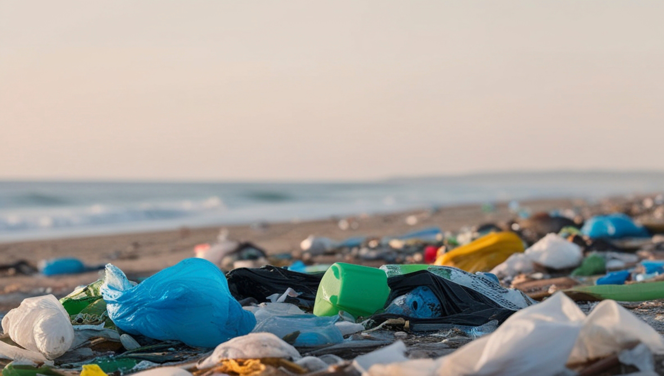
Aim of Study
To analyse the technical and economic viability of converting plastic waste into diesel fuel in Nigeria using a selected plant as a case study.
Notes:
3

Slide 6
  To assess the technical feasibility of the process of converting plastic waste to diesel fuel.
  To evaluate the economic and financial viability of the diesel-to-fuel conversion process by estimating the related expenditures, potential revenue and discounted cash-flow indicators.
  To conduct sensitivity analysis to identify the key technical and economic parameters
  To evaluate the economic performance of the process under alternative diesel-price scenarios in Nigeria.
Study
Objectives

Slide 7

Significance of Study
Provides a structured analysis of whether plastic-to-diesel conversion may be technically and financially feasible under the stated Nigerian case-study conditions.
Provides scenario and sensitivity results to show how uncertainty in yield, prices, CAPEX and operating conditions may affect investment decisions.
Identifies major cost drivers and operational constraints that plant operators and potential investors should consider.
Contributes a case-study perspective to the limited context-specific evidence on the economics of plastic-to-fuel conversion in Nigeria.
Notes:
4

Slide 8
Literature Review
LITERATURE | REVIEW | GAP
Maitlo et al. (2022); Al-Salem et al. (2017) | Studies reveals that mechanical recycling is constrained by mixed and contaminated plastics, making chemical recycling, particularly pyrolysis, an attractive alternative for recovering value from plastic waste | Existing studies focus mainly on technical feasibility and provide limited assessment of commercial implementation under Nigerian conditions.
Sharuddin et al. (2016); Lopez et al. (2017) | Studies reveal that pyrolysis can convert PE, PP and PS into high-quality liquid hydrocarbons, with product yield strongly influenced by feedstock composition, reactor temperature and residence time. | Most studies are laboratory or pilot-scale investigations rather than evaluations of operational industrial facilities.
Fivga and Dimitriou (2018) | The study used Aspen HYSYS to simulate a plastic pyrolysis plant processing 100 kg of plastic waste per hour. The researchers estimated a fuel production cost of £0.87/kg, which was 58% higher than the prevailing market price. | Supports basis for operating cost estimation, scale-up analysis, and financial indicators such as payback period and net present value (NPV). However, its fuel product and UK economic assumptions differ from Nigerian plastic-to-diesel case.
Osung and Alabi (2022) | The researchers modelled industrial-scale plants using Aspen Plus to compare thermal and catalytic pyrolysis of heterogeneous plastic waste. | It is Nigerian context relevant but not based on an actual operating plastic pyrolysis plant.

Slide 9
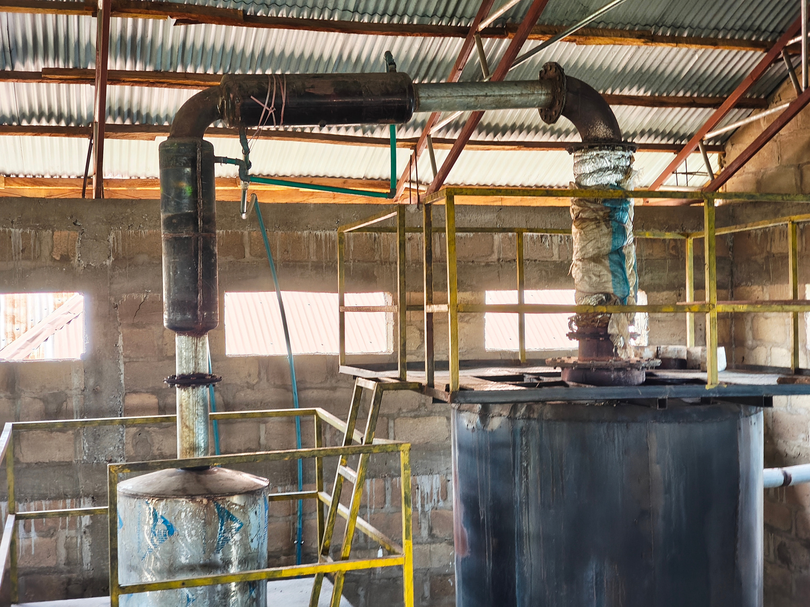
About Premium Blue
  Based in Ilorin, Kwara State, Nigeria
  Converts PP, PE, PS plastic waste to diesel fuel
  Daily production capacity of 2500L of diesel
  Uses palm kernel shell waste as primary heat source
  Uses syngas generated during production as secondary energy source
  Only known operational plastic-to-diesel-plant in Nigeria

Slide 10




Research Methodology
Research Design
Technical Analysis
Case study design integrating quantitative and qualitative approaches. Premium Blue Economy Innovation & Investment Ltd. (Ilorin, Kwara State) as primary unit of analysis. Data collected Feb–May 2026 via structured questionnaire and site engagement.
Estimation of annual diesel production from daily output and operating schedule, plastic feedstock requirement using a yield basis. Estimating mass balance and energy balances in the process
Financial Model
Sensitivity & Scenario Analysis
Excel is used to analyse the CAPEX (equipment, installation, engineering, etc), OPEX (feedstock, labour, utilities, maintenance and others), Unit production cost and the Cash-flow model (forecast project-period revenue and costs and calculate NPV at the 15% discount rate, IRR and payback period)
Sensitivity analysis is performed with the excel model to vary key technical and economic inputs; and scenario analysis to compare low, base and high diesel-price cases.
Notes:
8

Slide 11
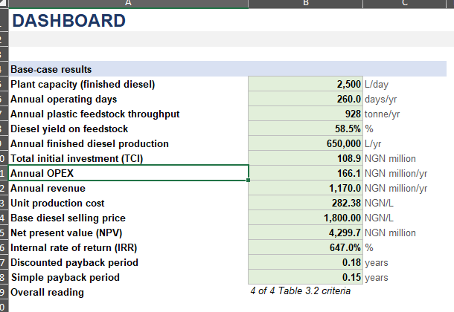
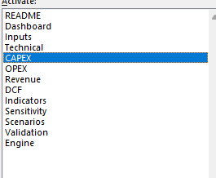
Research Methodology
Notes:
8

Slide 12
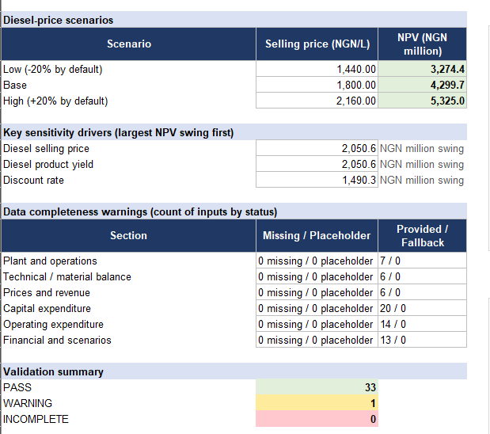
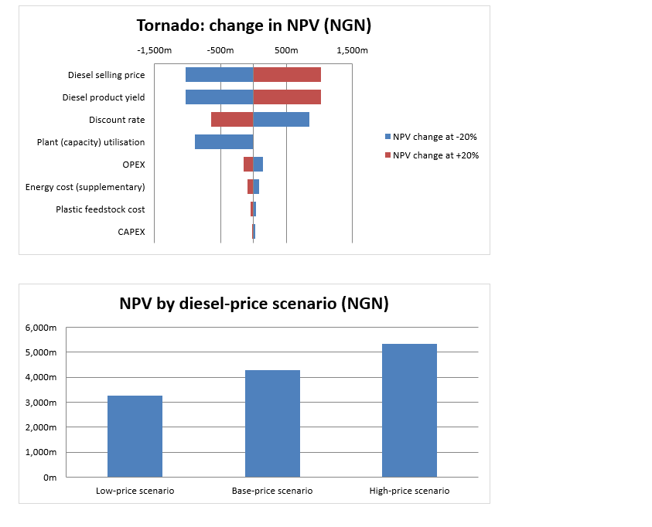
Research Methodology
Notes:
8

Slide 13
Conclusion
The study will analyse both technical performance and financial viability as a stated production capacity alone is not proof of profitability.
It will use verified plant data wherever available and clearly label literature inputs and engineering assumptions.
It will prioritise reliable records for feedstock use, saleable diesel output, energy consumption, downtime, maintenance and product quality.
And it will base investment or scale-up recommendations on the completed model results, uncertainty analysis and the product's demonstrated market specification.
Notes:
10

Slide 14
References
  Sharuddin, S. D. A., et al. (2016). A review on pyrolysis of plastic wastes. Energy Conversion and Management, 115, 308–326. https://doi.org/10.1016/j.enconman.2016.02.037
  Fivga, A., & Dimitriou, I. (2018). Pyrolysis of plastic waste for production of heavy fuel substitute: A techno-economic assessment. Energy, 149, 865–874. https://doi.org/10.1016/j.energy.2018.02.094
  Solis, M., & Silveira, S. (2020). Technologies for chemical recycling of household plastics—A technical review and TRL assessment. Waste Management, 105, 128–138. https://doi.org/10.1016/j.wasman.2020.01.038
  Fahim, I., et al. (2021). (Review/study on plastic pyrolysis; verify full bibliographic details before final submission). Polymers, 13(6), 915. https://doi.org/10.3390/polym13060915

Slide 15
Thank you

